Slide 1



TEAM BLOOPERS
BLOCKSPY- SECRET AI AGENTS FOR CRYPTO CRIME DETECTION
INDIA’S FIRST AI SURVEILLANCE AGAINST HIDDEN CRYPTO CRIMES

Slide 2

BLOOPERS PRESENTS
BLOCKSPY
Name:-Parthiban G
Email:-727823tuio035@skct.edu.in
College:-Sri Krishna College Of Technology
Name:-Ponmadhan D
Email:-727823tuio037@skct.edu.in
College:-Sri Krishna College Of Technology
Name:-Prem S
Email:-727823tuio039@skct.edu.in
College:-Sri Krishna College Of Technology
Name:-Shakhib Akthar S
Email:-727823tuio035@skct.edu.in
College:-Sri Krishna College Of Technology

Slide 3

THE CRYPTO CRIME WE CAN’T SEE
Problem Statement ?
India is the world's largest adopter of cryptocurrencies, but this growth encourages tax evasion and money laundering through NFTs, P2P wallets, and mixers. Regulators are ill-equipped to proactively monitor decentralized crime. Only after the fraud has been committed do current forensic tools detect patterns.
Project Description ?
BlockSpy is a secret surveillance system driven by AI that imitates actual users and blockchain smart contracts. It uses NLP models, honeypot contracts, and synthetic identities to identify dark web scams, suspicious wallets, and laundering routes in real time. Anonymized reports are safely transmitted to authorities without compromising user privacy or that requires installation.
PROBLEM STATEMENT

Slide 4



MEET BLOCKSPY: YOUR AI CRIMEBUSTER
What is BlockSpy ?
BlockSpy is a secret AI agent network that represents as a criminal to detect cryptocurrency tax fraud and money laundering patterns before they get successful.
Why it's Better ?
Does not wait for criminal activity to occur
Not dependent on user installation
Uses avatars and wallets created by AI
Uses secure, encrypted alerts to report only verified threats

Slide 5

HOW BLOCKSPY WORKS
BEHIND THE BLOCKCHAIN CURTAIN
Key Features:
No manual tracing required AI tracks the laundering trail autonomously
operates in secret all public blockchain data is used, and private data is not accessed.
Rapid detection before it's too late with real-time threat scoring

Slide 6
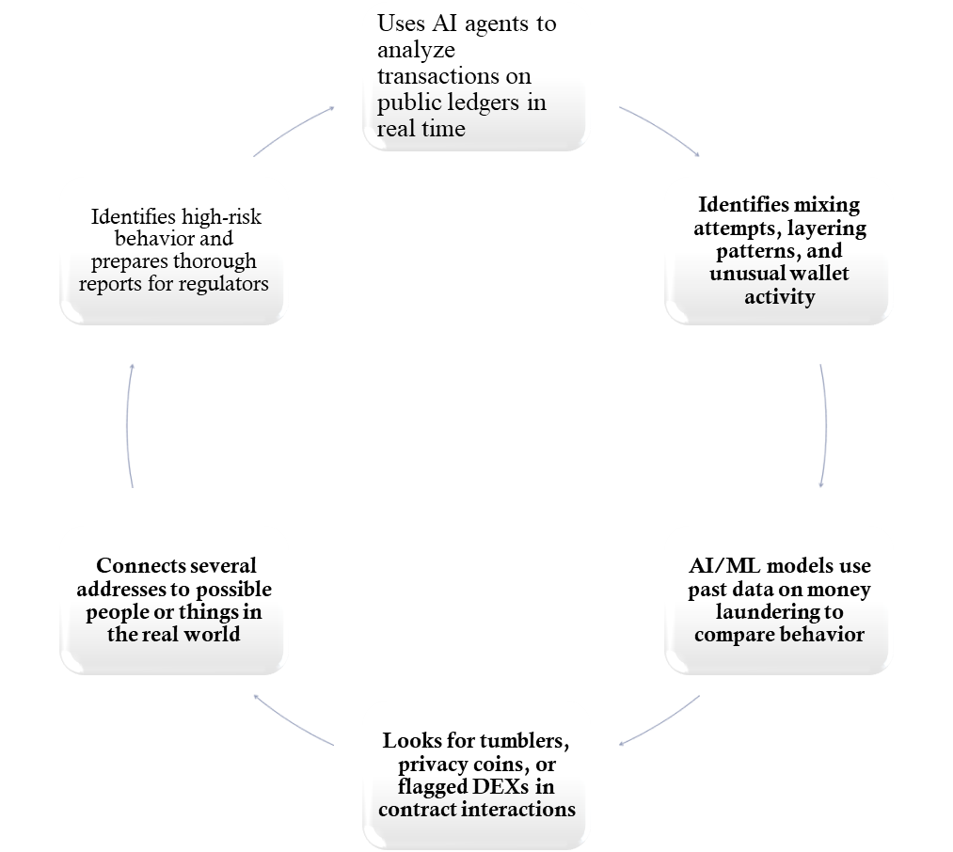
Wardiere.inc
BEHIND THE SCENES
THE CRYPTO-LAUNDERING DETECTION PROCESS
BlockSpy
Process

Slide 7
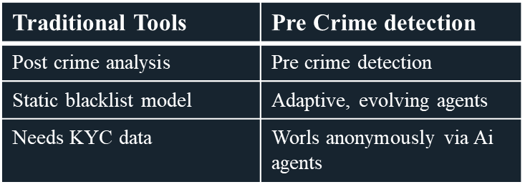
BUILT DIFFERENT. BECAUSE WE HAD TO.
INNOVATION & UNIQUENESS
actions that take place within the criminal network rather than outside of it
The first to detect fraud using LLMs, blockchain, and cyber intelligence
It is self-embedded and independent of user behavior or login
uses AI-bots and real-time wallet graph analysis on the dark web

Slide 8

TECHNICAL ARCHITECTURE
WORKFLOW
Start
AI Personas
(Fake Wallets)
NLP Bots
Honeypot Smart
Contracts (NFT)
AI Brain
(GNN + NLP Engine)
Encrypted Reporting Engine
(AES + IPFS Report to Govt)
External Forums
Telegram/Reddit
Finish
Tech Stack Used:
AI / ML - Hugging Face Transformers, Graph Neural Networks
NLP Bots - Python, Telegram API, Discord API, Reddit API
Blockchain - Solidity, Ethereum, Chainlink
Security - AES Encryption, IPFS (InterPlanetary File System)
Fraud Tracking - Custom AI engine for laundering pattern detection

Slide 9
IMPLEMENTATION
PREVIEW
MVP Modules:
Telegram NLP Scam Bot - Analyzes group chats (Telegram) to detect scammy phrases using NLP
Smart Contract Honeypot - Fake staking/NFT smart contracts deployed on Ethereum test net to bait scams
AI-Generated Wallets - CLI tool to simulate realistic wallets with fake transaction trails
Real-Time Dashboard - Displays fraud patterns & laundering networks graphically using Neo4j
Layers & Tools Used:
Frontend(React.js) – Interactive dashboard & monitoring interface
Backend(Node.js, Python) – APIs, bot logic, AI pipelines
Blockchain(Web3.js, Hardhat, Solidity) – Smart contract simulation & testnet deployment
Fraud Engine(Neo4j (graph DB), PyTorch) – Detects laundering patterns & wallet links

Slide 10
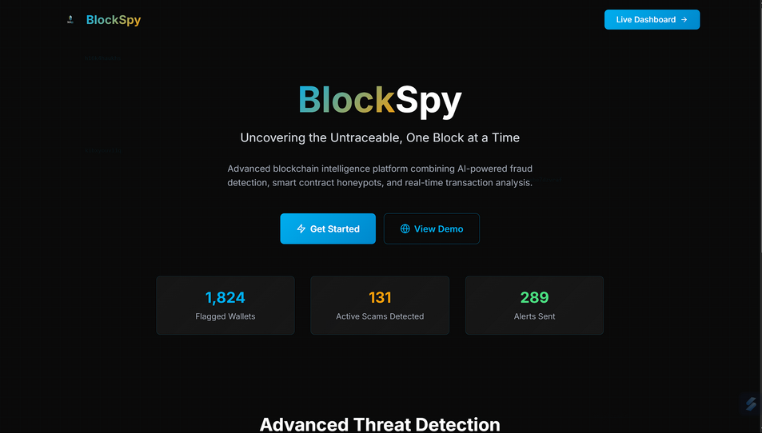
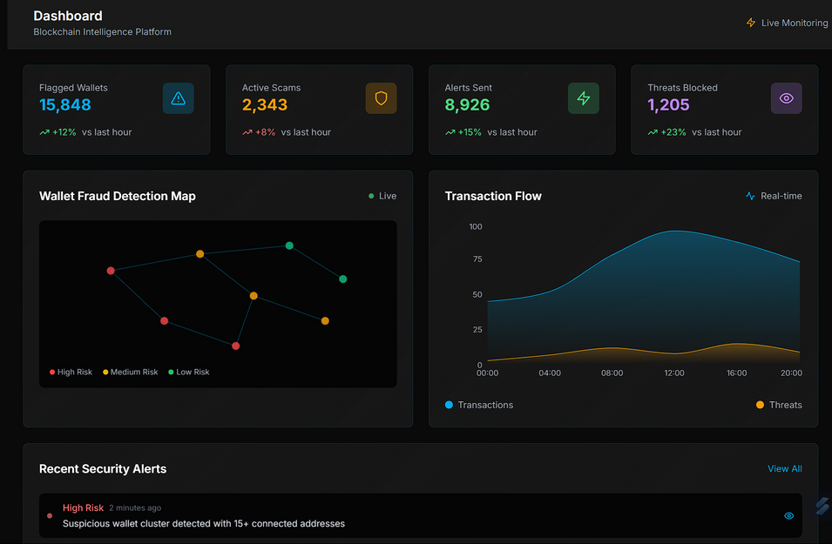
PROTOTYPE
THE DIGITAL FACE OF BLOCKSPY
About Page
Fraud Analysis

Slide 11
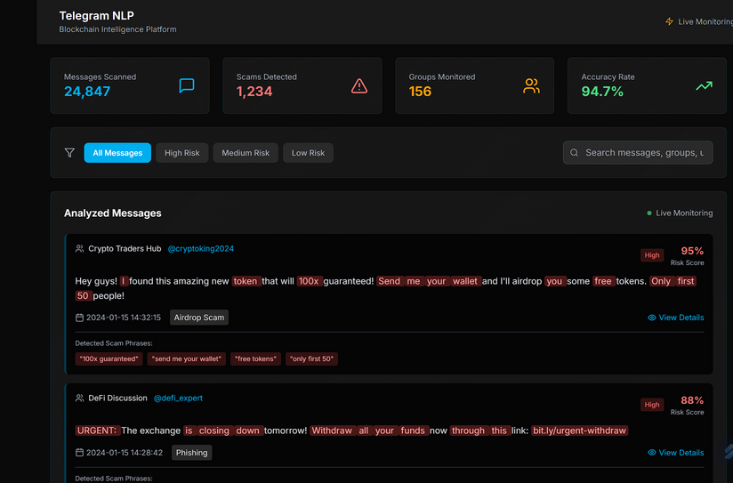
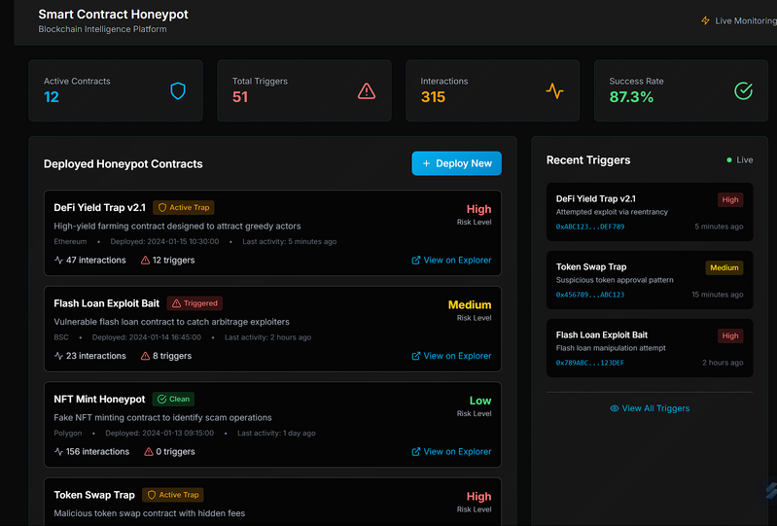
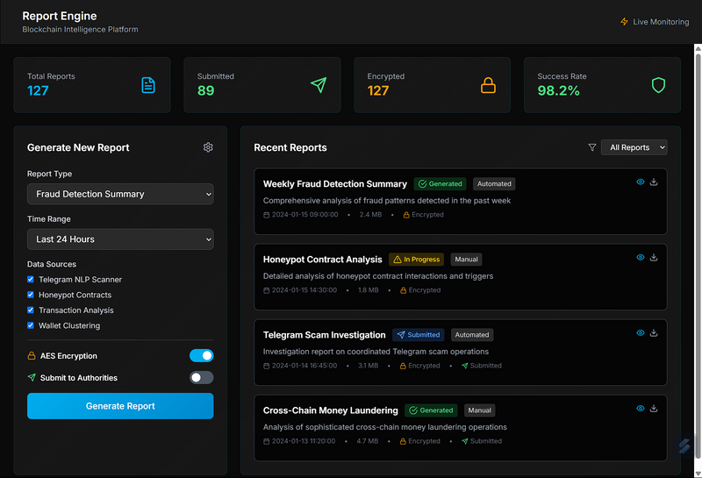
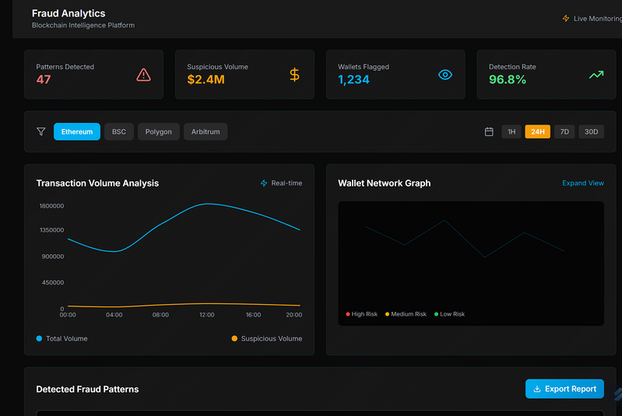
PROTOTYPE
Telegram NLP
Smart Control Honeyport
Report Engine
Fraud Analysis

Slide 12




MARKET SCOPE
FEASIBILITY
Scalability:
Expandable to multiple blockchains (Polygon, Solana, BNB Chain)
Can integrate with ED, FIU, Income Tax systems via API
Implementation Cost:
Initial MVP: ₹30,000–₹50,000
Full system (cloud + training + contracts): ₹1–2 Lakhs
Real-World Feasibility:
Can be piloted with Cybercrime cells
Adaptable for countries with high crypto usage

Slide 13

CHALLENGES FACED
WHAT ALMOST STOPPED US
CHALLENGE 1: ENSURING ANONYMITY OF AI AGENTS WITHOUT EXPOSURE
Problem:
Deploying AI personas (wallets and bots) without revealing they are honeypots or surveillance traps.
Solution:
Encrypted wallet identities
Rotating personas using realistic transaction patterns
Hosted on private IPFS nodes for stealth
CHALLENGE 2: AVOIDING FALSE POSITIVES FROM INNOCENT WALLETS
Problem:
Some normal users or wallets may look suspicious in isolated contexts.
Solution:
Multi-signal validation system combining NLP, graph patterns, and wallet history
Human-in-the-loop filtering to validate before reporting

Slide 14
SQUAD GOALS
TEAM BLOOPERS
Parthiban G
- Designed AI brain, wallet behavior, and deployed smart contracts on testnet
Prem S
- Built Telegram NLP scam bot and integrated Reddit/Discord monitoring
Ponmadhan D
- Created frontend dashboards, UI mockups, and conducted crypto laundering research
Shakhib Akthar S
- Ensured encrypted reporting, handled deployment via IPFS and backend infrastructure

Slide 15

CONCLUSION
Why We Should Win
Final Pitch:
BlockSpy is a revolutionary AI-powered undercover surveillance system created especially to identify and report blockchain-based cryptocurrency tax fraud and money laundering. utilizing a special blend of NLP monitoring, smart contract traps, AI agents, and safe encrypted reporting.
BlockSpy:
Acts proactively before damage occurs
Operates anonymously and ethically
Supports India’s cybersecurity & digital finance mission
Bridges blockchain with real world governance
We're creating trust in the decentralized world, not just a tool.
THANK YOU!

